Slide 1

Elementary Graph Algorithms: Strongly Connected Components
CLRS Chapter 22.5

Slide 2
What is a Strongly Connected Component
A maximal subset C of the vertices of G such that for any pair (u, v) of vertices in C, there is a directed path from u to v and v to u.
Example:

Slide 3
The Algorithm, getting ready
We need to find the transpose of G, G^{T}
G^{T} is G with the edges reversed: (u,v) becomes (v,u).
We can compute G^{T} in O(|v| + |E|) time, .going over each edge in the adjacency list
G^{T} and G have the same strongly connected components. (why?)
We can then use DFS to compute the strongly connected components of G.

Slide 4
Finding the Strongly Connected Components
Call DFS(G) to compute finishing times u.f for each vertex u.
Compute G^{T}
Call DFS(G^{T}); in main body consider vertices in order of decreasing u.f.
Each tree in the DFS forest will be a connected component.
Running time is O(|V| + |E|).

Slide 5
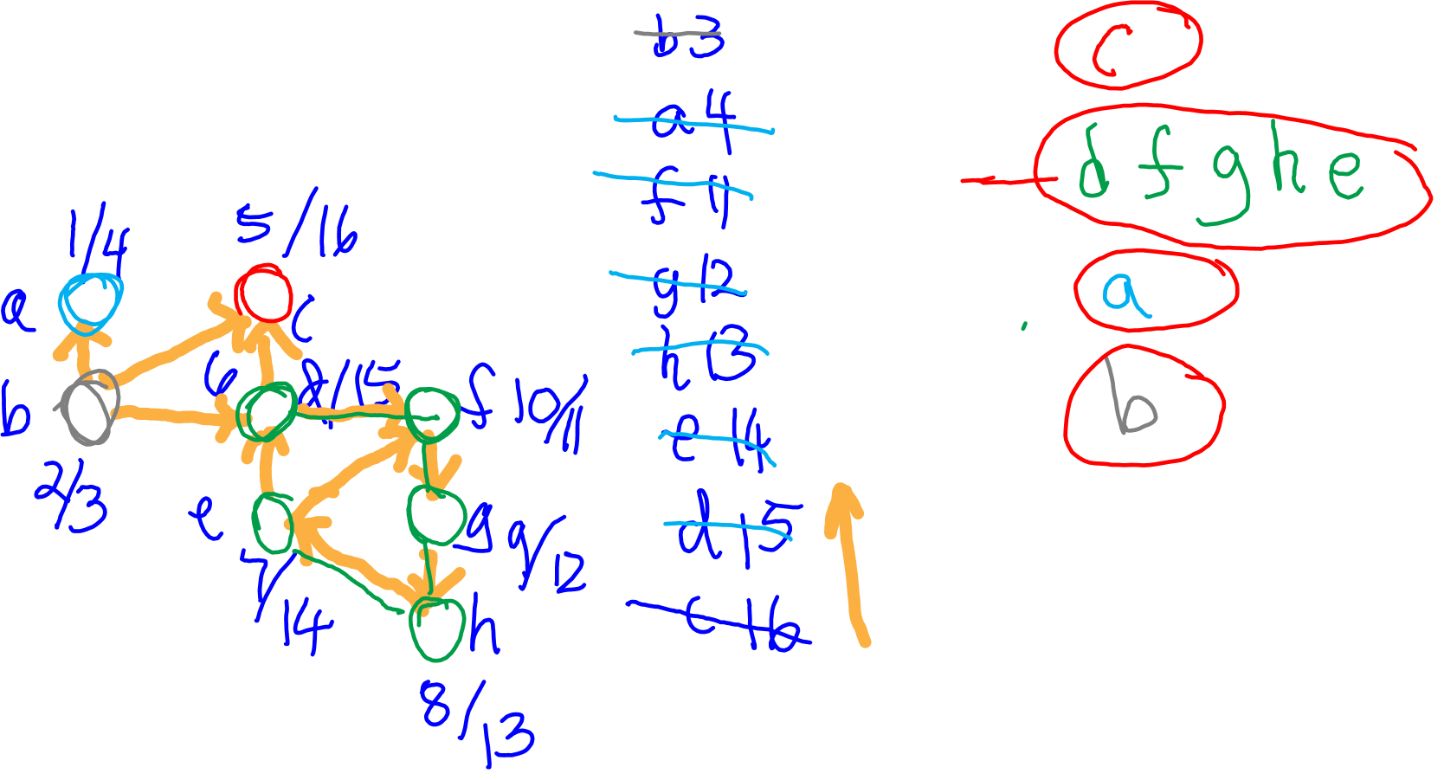
An Example

Slide 6
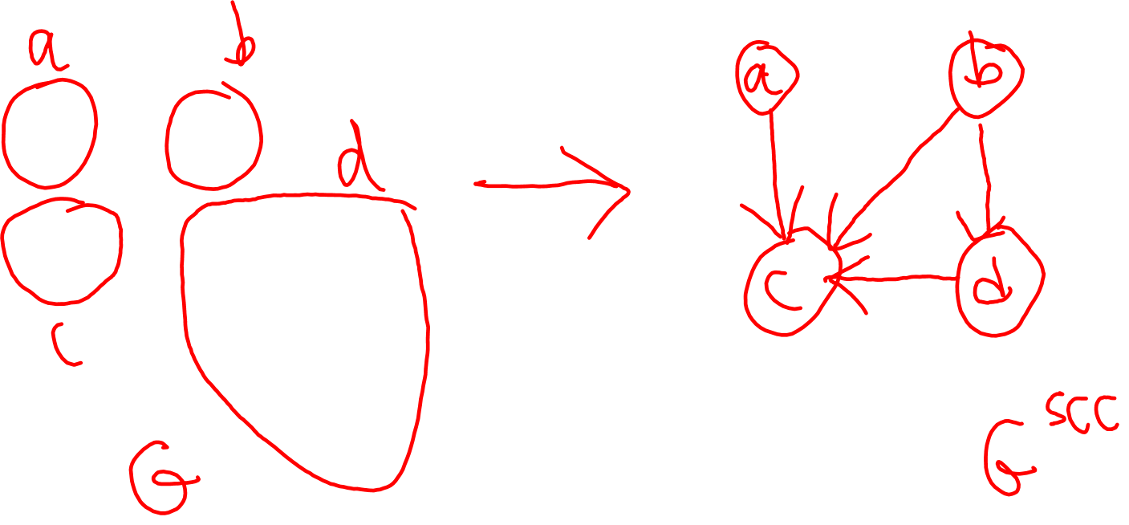
SCC Graph G^{SCC}
We collapse each SCC of G into a node.
Two nodes in G^{SCC} are connected by an edge if any of their members are connected by an edge in G.

Slide 7
Properties of G^{SCC}
Let C and C’ be SCCs in G. Let u, v be vertices in C and u’, v’ in C’. If there’s a path from u to u’ in G, there cannot be a path from v’ to v in G.
Proof idea: it would mean that C and C’ can be merged into one SCC.
Implication: G^{SCC} is a DAG!

Slide 8
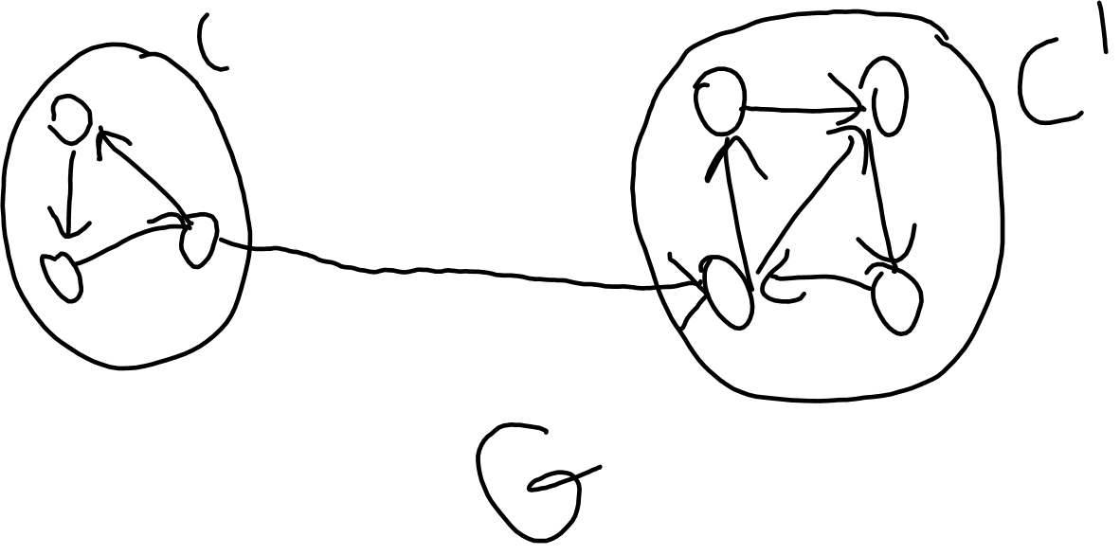
Finishing Times of Nodes of SCC
Lemma: Let C and C’ be two SCCs of G. If there’s an edge from C to C’, then finishing time of C is after that of C’.

Slide 9
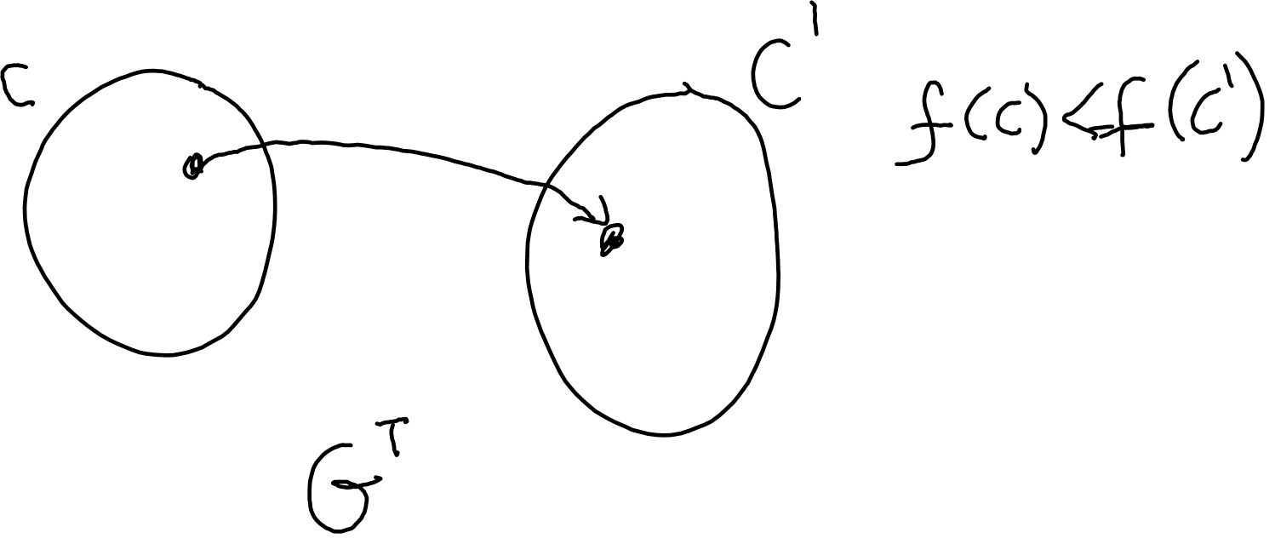
Finishing Times on G^{T}
Corollary: Let C and C’ be two SCCs of G. If there’s an edge from C to C’ in G^{T}, then finishing time of C is before that of C’.

Slide 10
Correctness of the SCC Algorithm
Consider the DFS we perform on G^{T}:
First vertex we consider belongs to some SCC C whose finish time is highest.
By previous corollary, C cannot have edges going to other SCCs in G^{T}. So we will not visit any other components. The resulting tree will be the same as C.
Once we finish C, we move to the next component, and the same argument applies.
Thus, each DF tree is a SCC.

